Slide 1
Brunel University buy and sell*
*Name not decided yet

Slide 2
Brunel Buy and Sell*
What is Brunel Buy and Sell?
This application is all about buying and selling within students at Brunel University.
How did you get the idea?
The idea and motivation came from a Facebook page which Brunel students use to advertise their goods but it is very inconvenient as many people don’t know about the page or don’t use Facebook.
By making this app we wish to make it easier for students to buy and sell goods.
Who is the target market?
Our target market is the students at Brunel university.
There are around roughly 1300 students who use this page already.

Slide 3
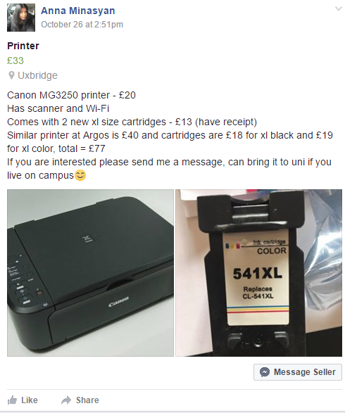
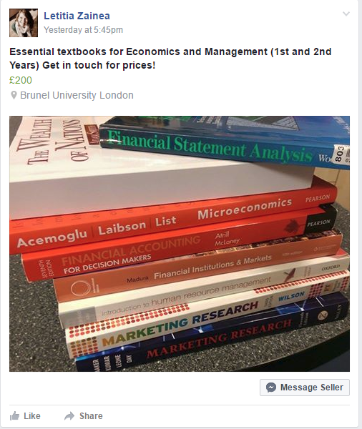
Facebook page
These are the types of
products on sale.
Students tend to buy and sell books for cheaper making it extremely helpful for new students.
Useful electronics such as printers, TV, laptops and more are put on sale.

